Slide 1



Securing Your Web Apps With AWS Security Agent
Thinh Nguyen
DevOps/DevSecOps/Cloud Engineer
Styl Solutions
First Cloud AI Journey
© 2025, Amazon Web Services, Inc. or its affiliates. All rights reserved.
© 2026, Amazon Web Services, Inc. or its affiliates. All rights reserved.

Slide 2
The Security Bottleneck
Time-consuming: Manual pentests take weeks.
Expensive: High daily rates for specialized humans.
Inconsistent: Coverage depends on the pentester's mood/skill.
High Operational Costs: Third-party audits cost $5k - $20k per engagement.
© 2026, Amazon Web Services, Inc. or its affiliates. All rights reserved.

Slide 3
Meet the Frontier Agent
Autonomous Reasoning
Full Lifecycle
Verifiable Findings
Powered by Amazon Bedrock, it plans and executes security tasks without human intervention.
Covers Design Review, Code Security, and Active Penetration Testing.
Unlike LLM chatbots, it verifies vulnerabilities by attempting real exploitation.
© 2026, Amazon Web Services, Inc. or its affiliates. All rights reserved.

Slide 4
Meet the Frontier Agent
Design Review
Code Review
Pentesting
Analyzes architecture docs before any code is written.
Scans PRs automatically for vulnerabilities and secrets.
Autonomous agent attacking your running application.
© 2026, Amazon Web Services, Inc. or its affiliates. All rights reserved.

Slide 5
Design Security Review
Upload Markdown docs or Terraform code.
Verify against Managed Packs (PCI DSS, NIST CSF, AWS Well-Architected).
Checks if design meets security "Requirements".
Free Tier: 200 reviews/month.
© 2026, Amazon Web Services, Inc. or its affiliates. All rights reserved.

Slide 6
Code Security Review
Integrated directly into your GitHub/GitLab Pull Requests.
Comments directly on lines of code.
Auto-PR Fixes: Suggests valid code patches.
Free Tier: 1,000 PR reviews/month.
© 2026, Amazon Web Services, Inc. or its affiliates. All rights reserved.

Slide 7
Automated Pentesting
Multi-step exploit chains (IDOR -> XSS).
Authenticates like a real user.
Detailed attack graph & verifiable proof.
© 2026, Amazon Web Services, Inc. or its affiliates. All rights reserved.

Slide 8
The Pricing Reality
$50
$50
Free Trial:
✔ 2 Months Trial
✔ 400 Task-Hours / Month
Real World Case Study
Project Duration: 6 - 10 Hours of setup.
Agent Work: 30 - 50 Task-Hours.
Total Cost: $1,500 - $2,500.
Per Task-Hour
Pay-as-you-go based on agent execution time.
"Is it expensive? Compared to a free scanner, yes. Compared to a $10,000 Pentest team, it's a bargain."
© 2026, Amazon Web Services, Inc. or its affiliates. All rights reserved.

Slide 9
Critical Limitations
Auth Blocks
Logic Flaws
Task-Hour Accumulation
MFA, Biometrics, mTLS will stop the agent in its tracks.
Difficult to detect business-logic fraud without deep context.
Complex apps burn hours fast. Monitoring is mandatory.
© 2026, Amazon Web Services, Inc. or its affiliates. All rights reserved.

Slide 10


AWS Security Agent Demo
© 2026, Amazon Web Services, Inc. or its affiliates. All rights reserved.

Slide 11

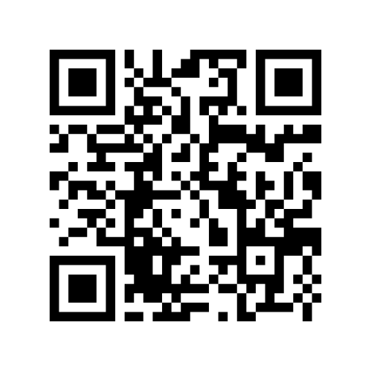
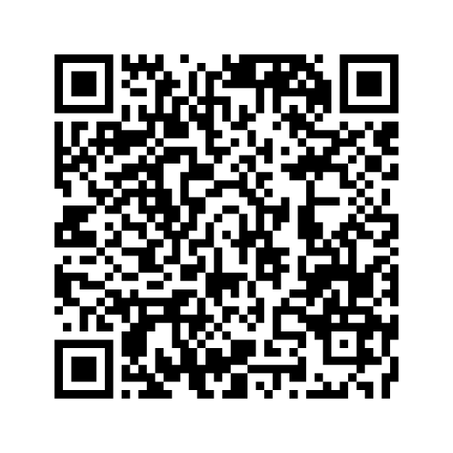

Thank you
Thank you!
Thank you!
Please complete the session survey in the mobile app
Nguyen Tuan Thinh
LinkedIn Profile
Resources
© 2025, Amazon Web Services, Inc. or its affiliates. All rights reserved.
© 2026, Amazon Web Services, Inc. or its affiliates. All rights reserved.
© 2023, Amazon Web Services, Inc. or its affiliates. All rights reserved.

